Slide 1



COMPANY
INTRODUCTION 2018
OVER 15 YEARS IN DIGITAL WORLD
Presented By: SRM TECHSOL PVT. LTD.

Slide 2


WHO WE ARE
SRM Techsol Pvt. Ltd. (www.stpl.biz) is one of the leading Global Software Engineering and IT management service provider catering result-oriented and cost-competitive solutions to it’s global clientele.

Slide 3

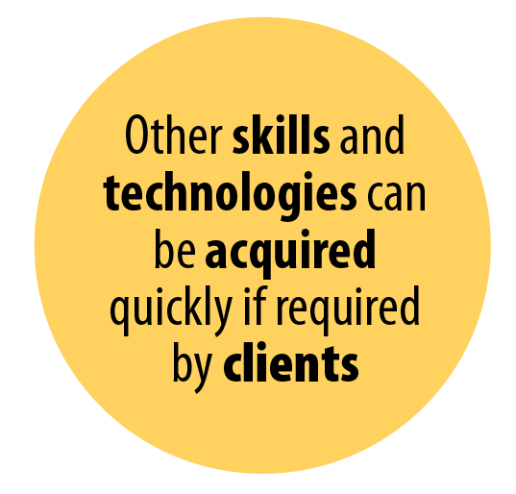
ABOUT US
SRM Techsol Pvt. Ltd. CMMI Level 3 Appraised and an ISO 9001:2008 certified offshore software development company with a strong team of highly skilled IT experts, catering its global clientele with innovative cost-effective solutions across different industry verticals.
STPL a NASSCOM accredited Microsoft Gold certified Partner is headquartered in San Mateo, California and is an undertaking of the SRM Group.
Infrastructure and Communication
State of the art Facility to support 200+ professionals, short turn around time needed to ramp up the facility in order to support up to 500 professionals. Capable to support continuous operations with: Full Electrical Power Backup, Dual Internet Connectivity, Servers as needed and the ability to work around the clock. We communicate effectively & promptly using Phones, Instant Messengers and web meeting software
Mission
Development
Center CEO
As a Global Software Engineering and IT management service company our mission is to enhance Corporate ability and performance through technology and computational power
Development Center structured to leverage best of breed applications
Admin & HR
Data Center
IT Infrastructure
200+ professionals from different IT domains with experience ranging from 3 to 25 Years
Multi-Skilled Senior Managers with Master Degrees in Engineering
Quality Assurance, Graphic Design and IT Infrastructure groups provide services across the development groups
Our staff is provided exceptional opportunities for professional growth and self-actualization.
Graphic Design
Quality Assurance/
Testing
Company’s Executive Team
STPL leadership team is Comprised of Engineering Graduates from the leading institutions of India and US: IITs, Berkeley, MIT, and Stanford, with Entrepreneur back ground. They have held previous strategic roles at companies such as Oracle and Microsoft. They have many years of knowledge and experience in delivering high quality and successful projects. The founders of STPL have also performed cutting edge research for top commercial & government clients in the fields of Data Mining and RFID applications and Business Intelligence and Analytics.
Open Source
Technology
PHP, LAMP
Microsoft
Technology
Java, IBM
Network
Support
Project
Managers

Slide 4
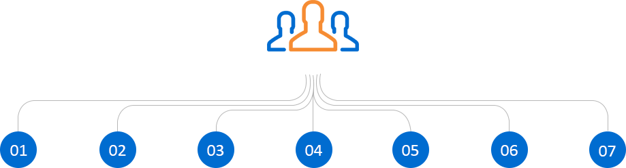
Incorporation of New Teams as per the requirements
People are aligned to projects in accordance to their skills and experience
Graphic Designers/Testers/ Business Domain Experts can be part time assigned to a project, and render concurrent services to multitude of projects
For projects that need to ensure continuity and redundancy, Secondary Project Manager as well as Secondary Account Manager can be assigned
Test Engineers (*) have a distinct career path and a dual reporting responsibility-they report to the Project Manager and to Quality Assurance team at the same time
Projects that have an on site presence with client, offshore resources are the larger part of its cost
Development Center CEO
_{Business Domain}
_{Application} _{architects/analyst}
_{DB Designers}
_{Developers}
_{Graphics Designers}
_{Testers (*)}
_{Projects Manager}
Each Project Manager Maintains Its Work Logs, Productivity Indicators, And Manages Its Full And Part Time Staff

Slide 5

OUR SERVICES
We work with our IT partners to solve challenging architectural design problems for their clients

Slide 6
STPL OFFERS THE FOLLOWING SERVICES
Application and Product Development
Application Support and Maintenance
We work with our IT partners to solve challenging architectural design problems for their clients
We can help to define, design, build and implement applications, that include communications, front and back end office operations, with a substantial out reach to clients and their associates. New applications that can reshape the clients mode of operation with value added, better service, improved precision, lower operating cost and greater efficiency functionality, enabling the client to better compete in the marketplace
We work with our partners to help them maintain or evolve their client’s legacy systems, and to create interfaces between systems to automate other portions and improve the overall performance of the applications. This can freed the partner’s skilled & experienced staff to undertake newer and higher value projects
Consulting Services
We use our superior project management skills to help software companies define and implement world-class software engineering practices and processes which are in line with internationally acclaimed models, and/or provide IT Visioning Plans
Application Testing Services
Dedicated Quality Assurance group is available to undertake Application Testing Assignments. The team is equipped to carry out Black Box (Functional Testing) as well as Code Reviews and Load Testing. The team also has undertaken testing for Sec 504 and 508 Compliance assessment for physically challenged users
CAD Solutions
We provide CAD related services like SolidWorks, Paper to CAD conversion, Reverse Engineering, 3D Modeling and Rendering, Drafting Services in Civil Engineering, Mechanical Engineering and Electrical Engineering.

Slide 7

WE USE TECHNOLOGIES
The question of technology is usually a concern of a service provider, and we always choose the programming languages and technologies suitable for project aims, size and budget.

Slide 8
TECHNOLOGIES
The question of technology is usually a concern of a service provider, and we always choose the programming languages and technologies
suitable for project aims, size and budget. However, we are always attentive to all your requirements and wishes, including technological
preferences. In any case, we choose the best technologies to optimize the project.
Web & Application Technologies
Design Studios
PHP, ASP.NET, XML, Java, JSP, J2EE, EJB, Embedded Technologies, ASP, Visual Basic, WML, WAP, CGI/PERL, Cold Fusion & Ruby on Rails (RoR)
Dreamweaver 8.0, Macromedia Flash 2005, Flex, Director, Shockwave, Photoshop CS2, Freehand, CorelDraw, Illustrator, Fireworks, Go live, Aftereffects, Painter, 3d Studio, Maya, Bryce etc.
Database Platform
MySQL, MS SQL Server 2005, Oracle 9i, MS Access
Mobile App Development
Native iOS and Android Development, Hybrid Apps on Ionic, Phonegap, Angular, Cordova
Open Source
PHP, Drupal, Zend, CakePHP, Laravel, Wordpress, Woo Commerce, Magento
Big Data, Business Intelligence and CRM
Hadoop, Cassandra, Postgresql, NoSQL, DOMO, Sumo logic MS Dynamics, SharePoint, Salesforce
Cloud Technologies
Cq5, Azure, Cloud Migration, Vignette & Hadoop, Big Data, IoT,BI.

Slide 9

INDUSTRY VERTICALS
Collaborating to develop advance solutions for diverse industry verticals

Slide 10













INDUSTRY VERTICALS
Collaborating to develop advance solutions for diverse industry verticals
Our services covers diverse industry verticals including
e-Governance
Real Estate
Healthcare
Education
Hospitality
CRM
ERP
Logistics
Retail
Supply Chain
Management
Data
Warehousing
Social
Networking

Slide 11

QUALITY
AND PROCESSES
Processes are tailored to tune in with specific project and client requirements ensuring management and control for the development processes

Slide 12





QUALITY & PROCESSES
Employs Processes That Produce High Quality Results
CMMI Level 3 Appraised and an ISO 9001:2008 certified offshore software development company with a strong team of highly skilled IT experts, catering its global clientele with innovative cost-effective solutions across different industry verticals.
Our expertise in technology and business may recommend other features and functionalities not visualized by the client, such as system metrics, performance indicators, content management, backup and restore features, performance enhancer techniques, etc.
Processes are tailored to tune in with specific project and client requirements ensuring management and control for the development processes
Our modular design, may use prototyping as a means to develop a fast and workable application that saves time and money

Slide 13

ENGAGEMENT MODELS
STPL offers its clients in various flexible engagement models to manage client requirements that could be one-time or on-going multi-year projects.

Slide 14


ENGAGEMENT MODELS
STPL offers its clients in various flexible engagement models to manage client requirements that could be one-time or on-going multi-year projects.
STPL offers different engagement models to meet global clients' diverse needs.
Fixed Price Project Model
Time & Material Project Model
Dedicated Resource Model (DRM)
Fixed Price Project Model
Dedicated Resource Model (DRM)
STPL offers customers a Fixed Price Project Model when the project specifications are reasonably clear & the scope is defined.
This model goes hands & glove with projects which have scope, schedules and requirements clearly defined. Project time line & cost is finalized, then we select the most suitable development team and technologies and management resources to accomplish the project as agreed. Any new features or major changes later on are discussed and quoted separately.
Dedicated Resource Model (DRM) is the best model for clients who are looking for total control over resources involved into the development process. DRM brings in a high level of transparency, security, flexibility and scalability. All infrastructure and personnel are at client’s dedicated service in lieu of a fixed monthly fee.
Our offshore teams operates as an extension of the customer's development center. In this model, STPL incorporates project teams with the required team members, project managers, equipment and infrastructure based on client’s requirements.
The model allows the clients to leverage significant savings on staff, equipment and technology, and most importantly it gives them the option to concentrate more on their core business area instead of the technical part thus enabling them to reduce risk and gain a better position within their respective industry verticals
Time & Material Project Model
STPL gives customers greater flexibility to alter the project specification on an ongoing basis based upon upcoming market trends. The client pays a fixed hourly rate which is agreed at the time of contract signing. This model best works with regular & ongoing maintenance and support services.

Slide 15

DIFFERENTIATORS
STPL. allows it’s clients to entail tremendous cost advantages however our unique value proposition isn’t contained only to the project cost & covers multiple other business & technical aspects of the client’s business

Slide 16




DIFFERENTIATORS
STPL. allows it’s clients to entail tremendous cost advantages however our unique value proposition isn’t contained only to the project cost & covers
multiple other business & technical aspects of the client’s business
Access to an experienced team
Access to technological expertise
Reduce HR costs
Increase Project Management Capabilities
Timely Project implementation and completion
Knowledge and Expertise Continuity
Non-Circumvention agreement to ensure client base is retained by the Partner

Slide 17

OUR PRESTIGIOUS CLIENTS
A growing list of Prestigious Clients around the Globe are trusting STPL for its Quality and Persistence in Delivering Successful Projects within budget and timeline constraints.

Slide 18












OUR PRESTIGIOUS CLIENTS
A growing list of Prestigious Clients around the Globe are trusting STPL for its Quality and Persistence in Delivering Successful Projects within budget and timeline constraints.
v
v
v
v
v
v
v
v
v
v
v
v

Slide 19

e-GOVERNANCE
.

Slide 20

e-GOVERNANCE
Digital Infrastructure As Core Utility to Every Citizen
Helping every Citizen through e-Governance
SRMES Janmitra (Common Service Center/ Jan Seva Kendra)
UPDESCO - Unique Identification Authority of India (UIDAI)
Our vision for CSC is inspired by statement of Dr. APJ Abdul Kalam, former President of India “E-Governance has to be citizen-friendly. Delivery of services to citizens is considered a primary function of the government”
SRM Techsol Pvt. Ltd. Enrolment Agency for Enrolment of UID AADHAR Project.
The Project is running in 36 Districts
Priority given to the Age Group of 0 to 5 years
We have 20+ division offices across 36 districts
Registered 200+ Vendors across 36 districts
Over 75,000 AADHAR cards delivered
Targeting to add 150,000 AADHAR in the next two quarters
Janmitra Kendra
Jan Suvidha Kendra’ is initiative of the State Government UP to create a facility center at district headquarters of all districts with state of the art facility for providing G2C services to citizens.
Key Objectives of Janmitra Kendra
King George Medical University, Lucknow (KGMU, Luckow)
Web Based Digital presentation for KGMU, Lucknow
To provide G2C services comprising of 26 sub-services from Jan Suvidha Kendra’
To build up scalable E-District Center for meeting the expected growing preference of citizen for easy and efficient service delivery. Addition of more G2C and B2C services in service basket of e-District Center in due course of time is envisaged under this initiative.
To adhere to the service level agreement for saving time and cost incurred by government in providing services and citizen in availing the listed services.
To enhance the accountability, transparency and responsiveness of district administration to citizen's needs.
Software Development
Hardware for Digitization
Processing of raw Data and images with all Prescribed steps
Meta data creation on prescribed format
UP- Directorate of Economics and Statistics
Development of Software for Offline data Entry

Slide 21
e-GOVERNANCE
Paperless and Automated Solution for e-Governance
Project Management and Asset Management
The R-APDRP Project
Project Management Information System (PMIS)
The Ministry of Power, Government of India, has launched the Restructured Accelerated Power Development and Reforms Programme (R-APDRP)in 2002-03 as a Central Structure Scheme. Project is primarily divided into two parts:
Part A: includes projects for establishing baseline data and IT applications for energy accounting/ auditing and IT based consumer service centers etc. for towns with a population of more than 30,000 (10,000) in case of special category states. The scheme involves implementation of:
A web based and integrated Project Management Information Systems (PMIS), for infrastructure construction work to capture, manage and disseminate all project related data required for providing relevant, timely and updated project information to all stakeholders and to enable monitoring of project activities, inputs, outputs and results.
Grievance Redressal System
Financial Accounting & Cost Management System
Computer Aided Design (CAD) System
Risk Management Information System
Works Estimation System
Physical Progress & Financial Progress
Monitoring and evaluation (M&E) & Decision Support System
GIS based Consumer indexing and asset mapping
Meter data acquisition system (MADS) for distribution
SCADA in big towns and cities
Gyan Milk -Store Asset Management Software
Part B: It covers the strengthening, improvement and augmentation of the distribution system. This involves:
Bar Code Generation and track Assets
Procurement Process
Receiving & Inspection of Asset
Updating Fixed Asset Register
Record maintenance
Identification of high loss areas
Preparation of investment plans for the areas identified above
Implementation of plan
Monitoring of losses

Slide 22

ERP-SOLUTIONS
.

Slide 23
ERP-SOLUTIONS
EMM EMM Group
Hypfen - Ritz Fashion Pvt. Ltd
ERP implementation with 335 Users
Customization of required process
Web Portal Development
Data Center Setup
Cloud Set Up
Training for Candidates
Successful Implementation of 11 places under 1 Locations
System Study: AS Is & To Be
FRS for all 8 module
ERP Licenses purchase
Customized as per the requirement
Implementation
Go-Live
Training
3 Years Maintenance

Slide 24

GLOBAL
PROJECTS
.

Slide 25


GLOBAL-PROJECTS
ATA Services (https://ataservices.com/)
Realty Connection & On Task Mobile App
(https://www.realtyconnection.com/)
v
v
ATA Services combines a photo-driven mobile Data Collection app with a secure dashboard-based Asset Management platform. ATA Services empowers executives, owners and managers with the tools to evaluate and take action on the mountains of data required to make effective decisions.
Realty Connection was conceived as an opportunity for Real Estate Agents, Real Estate Companies, and all relevant industries to come together and share their information, expertise and knowledge.
Realtors can compare real estate commission splits and structures and be in contact with Real Estate companies (anonymously if desired); they can also learn about other career opportunities in the industry. Realty Connection provides a place to share all things related to Real Estate in a user friendly, highly functional, efficient and productive environment.
Project Scope
Easily view any asset in your network. Filter and sort by type, location, keyword or photo tag.
Verify that assigned work is complete and view all issues identified by personnel in the field.
Take action to resolve non-compliance issues as soon as they appear. No more blindsiding
Quickly visualize your network and key performance indicators on a customized dashboard
Generate standard and custom reports in Excel or PDF to easily share asset data with colleagues

Slide 26


GLOBAL-PROJECTS
Cartwire (https://www.cartwire.co/)
Labconnect (https://labconnectllc.com/)
v
v
CartWire is an e-commerce solution for brands of Unilever, enabling plug-and-play Buy It Now (BIN) functionality on web, social and mobile channels. This e-com solution we've successfully implemented in 200+ Unilever brand.com websites in 40 countries.
LabConnect provides global central laboratory services, including routine and esoteric laboratory testing, kit building, sample management, biorepository and scientific support services for biopharmaceutical, medical device and contract research organizations. LabConnect performs everything from general safety testing to the most complex molecular diagnostics and biomarker analyses.

Slide 27
ALLIANCES AND PARTNERS
STPL’s solution offerings are enabled by strategic alliances with technology vendors and system integrators—our partners in delivering industry’s best end-to-end solutions to our customers.

Slide 28
ALLIANCES AND PARTNERS
STPL’s solution offerings are enabled by strategic alliances with technology vendors and system integrators—our partners in delivering industry’s best
end-to-end solutions to our customers.
Microsoft
NAASCOM
UPDESCO
IBM
Deloitte
InGram
i-CAD

Slide 29

TOP
MANAGEMENT
STPL (www.stpl.biz) is one of the leading web development service provider catering result-oriented and cost-competitive solutions to it’s global clientele.

Slide 30
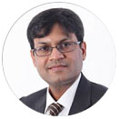
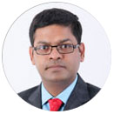
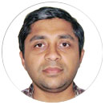
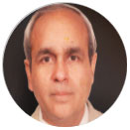
TOP MANAGEMENT
(CEO)
NEERAJ AGARWAL
(CTO)
NAVIN AGARWAL
Neeraj Agarwal, the CEO brings technical and strategic planning skills to STPL. He spent 3 years working as a consultant for McMaster-Carr, Chicago and has also done consulting for top US government clients. Neeraj holds a bachelors degree in Engineering from IIT Kanpur, a Master's degree in Engineering from University of Connecticut and a Master's degree in Information Technology from the Massachusetts Institute of Technology (MIT).
Navin Agarwal the CTO, graduated with a Bachelor of Engineering degree from University of Roorkee (now IIT Roorkee) and Master of Science in Engineering from University of Minnesota. He has worked with Conestoga-Rovers and Associates, Chicago.
(Advisor)
(Advisor)
KARUN JAIN
DINESH CHAND
Karun Jain, the Advisor in section of the Technical division brings operational and project management experience to STPL. Prior to STPL, he spent 6 years at a large Software Company, in California most recently as a Senior Product Manager for Supply Chain Management (SCM). He helped integrating the various Wireless and RFID Technologies for Oracle's SCM software. He graduated with a bachelor's degree in Electrical Engineering from IIT Kanpur and also holds an MS in Electrical Engineering from Stanford University.
The Advisor, has diverse background of 30+ years as a technology executive, entrepreneur and consultant. His distinguished career at ITC included the positions of Vice President, Information Systems, Corporate and CIO of ITC Hotels Ltd. Subsequent experience include CIO of Texmaco PE, Indonesia and as consulting roles to Rose International Inc. and Cynergy Systems VLSI, to setup their IT operations in India. He holds a bachelor's degree in Electrical Engineering from IIT Kharagpur and a Masters in Electrical Engineering from the University of California, Berkley.

Slide 31

LEADERSHIP TEAM
The STPL Leadership team is comprised of a diverse team of globally recognized executives with a combined 150+ years of business experience in engineering and design, product lifecycle management, manufacturing enterprise IT and innovation.

Slide 32
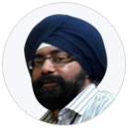
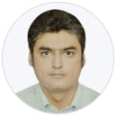
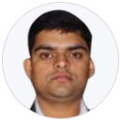
LEADERSHIP TEAM
BIBEK SINGH
(Sr. Project Manager)
SHOBHIT KAPOOR
(Business Analyst)
Bibek Singh is a Senior Project Manager at STPL. Prior to STPL, he spent over 17 years at Infosys Limited. He is an alumni of IIT Kanpur and IIM Calcutta. He also holds international certifications like PMP, ITIL, CSQA & Competent Leader from Toastmasters. He has expertise in managing large projects, coordinating with stakeholders and team management. He has over 7 yrs of international work experience and has been to countries like UK, Germany and USA for various project & sales assignments. He has won numerous awards including “Infosys Excellence Award”, the topmost award at Infosys Limited.
Shobhit Kapoor, (Business Analyst) brings in his ability to align the systems with business objectives and its implicit needs. Backed by a sound IT career in various organizations like Infosys, TCS, he has a unique way of streamlining projects into process-bound assignments. The IIT Kanpur Alumni has a different and varied perspective to almost everything
RAHUL SHARMA
(Sr. Technical Architect )
Rahul is a Technical Architect with more than 13 years of experience, with proven track record for providing successful solutions, spanning multiple technology platforms & products across different geographies and domains. He has delivered multiple solutions and has driven agile teams. His solutions ranges from Web, Mobility, IOT, Big data and Cloud. He has Product engineering experience starting from the stage of conceptualization to RTM.

Slide 33
SRM GROUP
SRM Techsol Pvt. Ltd. is one of the leading web development service provider catering result-oriented and cost-competitive solutions to it’s global clientele.

Slide 34
SRM GROUP OVERVIEW
SRM Techsol Pvt. Ltd.
Shri Ramswaroop Multi Engineering Solutions Pvt. Ltd.
SRM Techsol Pvt. Ltd. (www.stpl.biz) is one of the leading web development service provider catering result-oriented and cost-competitive solutions to it’s global clientele.
SRMES incorporated in 2015, is currently handling Government Projects of PUVVNL and CeGS Departments.
It is also planning to enter into LED Light Manufacturing very shortly as a part of regular growth and expansion policy of the SRM Group
Shri Ramswaroop Memorial Public School (SRMPS)
Shri Ramswaroop Memorial Public School (SRMPS) is a humble beginning in the enormous field of academics with a mission of developing confident individuals, infusing intense patriotic feelings, generating leadership and team spirit qualities and above all love and cooperation for fellow human beings. The School realizes its mission through the able guidance of the Advisory Board and Management.
SRM Smart Hoops Pvt. Ltd. (SRM STAR)
SRM Smart Hoop incorporated in 2012, is a dealership of Mercedes Benz Cars in U.P. with its showrooms at Lucknow and Kanpur and its workshop in Lucknow. As our group profile suggests we believe in strategic diversification and entrepreneurial approach towards business, which has helped us gain great levels of success, in a considerably short span, in every venture we have indulged in.
Shri Ramswaroop Memorial Group of Professional
Colleges
Shri Ramswaroop Memorial Group up of Professional Colleges is one of the leading institutes of higher education in India. The college stands for top notch graduate and undergraduate programs in Lucknow, the economic and political heart of Uttar Pradesh.
SRM Agro Products Pvt. Ltd.
SRM Agro Products Pvt. Ltd incorporated in 2012, primarily provides product and services for Food Processing and utilizes local crop to have logistical advantage.
Namaste LED
Namaste LED is leading the transformation of commercial and industrial buildings with state-of-the-art energy efficient lighting systems and retrofit lighting solutions. Orion manufactures and markets a cutting edge portfolio of products encompassing LED solid state lighting and high intensity fluorescent lighting.

Slide 35
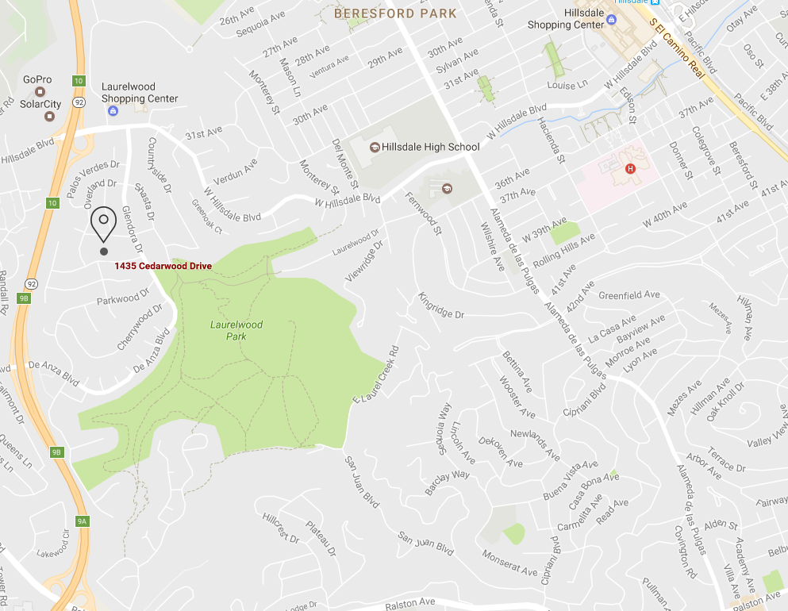



STAY WITH US
US HEAD OFFICE:
1435 Cedar wood Drive San Mateo, CA 94403 USA
Phone: 650-342-3960
Fax: 650-472-9036
E-mail: info@stpl.biz
OFFSHORE DEVELOPMENT CENTER:
B - 48, Sector - C, Aliganj Lucknow - 226024 UP, INDIA
+91-522-2328654
+91-9208601945
+91-522-2815017
FOR US CLIENTS:
+1-650-585-2906
+91-933-571-7921

